Slide 1
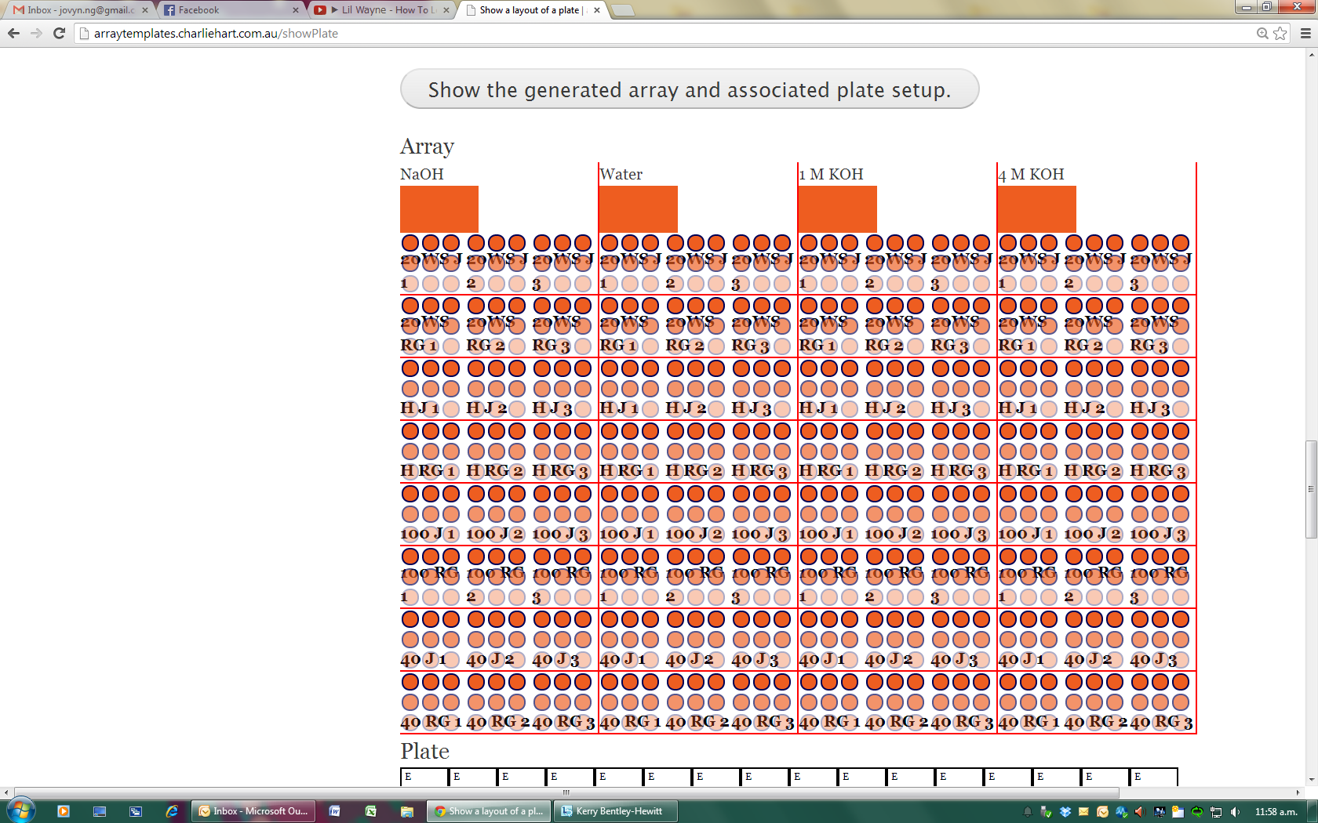
Water
Na₂CO₃

Slide 2
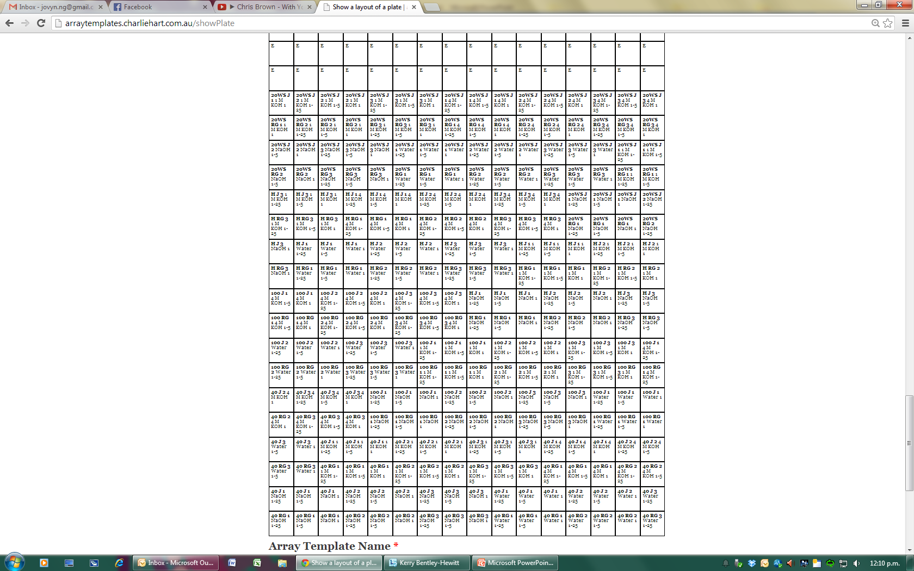
19
18
17
16
15
14
13
12
11
10
9
8
7
6
5
4
3
2
1
A B C D E F G H I J K L M N O P
Notes:
All the NaOH = is water-sol
All the Water = is Na2CO3

